Slide 1
Management Stephen P. Robbins | Mary Coulter
Chapter 08 Planning Work Activities

Slide 2
Learning Objectives
Define the nature and purposes of planning.
Classify the types of goals organizations might have and the plans they use.
Compare and contrast approaches to goal-setting and planning.
Know how to set goals personally and create a useful, functional to-do list.
Develop your skill at helping your employees set goals.
Discuss contemporary issues in planning.
© Pearson Education Limited 2016

Slide 3
What Is Planning?
Planning – Management function that involves setting goals, establishing strategies for achieving those goals, and developing plans to integrate and coordinate work activities.
Formal Planning
Specific goals covering a specific time period
Written and shared with organizational members
© Pearson Education Limited 2016

Slide 4
Why Do Managers Plan?
Four Reasons For Planning:
Provides direction – knows what to do and how to do
Reduces uncertainty – reduces chance of sudden negative occurrence
Minimizes waste and redundancy – work become coordinated and efficient
Sets the standards for controlling – planning helps to set specific goals hence controlling is measureable
© Pearson Education Limited 2016

Slide 5
Planning and Performance
Formal planning is associated with:
Positive financial results – Higher profits, higher return on assets, and so forth
The quality of planning and implementation affects performance more than the extent of planning
The external environment can reduce the impact of planning on performance
The planning-performance relationship seems to be influenced by the planning time frame (four years of formal planning is required)
© Pearson Education Limited 2016

Slide 6

Goals and Plans
Goals (objectives) – Desired outcomes or targets.
Plans – Documents that outline how goals are going to be met.
© Pearson Education Limited 2016

Slide 7
Types of Goals
Financial Goals – Related to the expected internal financial performance of the organization.
Example: Discount retailer Dollar General announced its plan to demonstrate sales growth of 7–10% in 2016, with earnings per share (profit divided by the total number of company stock shares) to increase by 10–15%.
Strategic Goals – Related to the performance of the firm relative to factors in its external environment (e.g., competitors).
Example: United Nations World Food Programs: to ensure that no child goes to bed hungry.
© Pearson Education Limited 2016

Slide 8
Types of Goals
Stated Goals – Official statements of what an organization says, and what it wants its various stakeholders to believe its goals are.
Example: Nike’s goal is “delivering inspiration and innovation to every athlete.”
Real Goals – Goals that an organization actually pursues, as defined by the actions of its members.
Example: Lose/Gain 10 Pounds by this time next year.
© Pearson Education Limited 2016

Slide 9
Types of Plans w.r.t Breadth
Strategic Plans – Plans that apply to the entire organization and establish the organization’s overall goals.
Example: Washington State Department of Health three year state strategic plan is designed to help residents maintain good health and prevent disease and illness.
Operational Plans – Plans that encompass a particular operational area of the organization.
Example: improve packaging and shipping procedures.
© Pearson Education Limited 2016

Slide 10
Types of Plans w.r.t Time Frame
Long-term Plans – Plans with a time frame beyond three years.
Example: Graduate from university
Short-term Plans – Plans covering one year or less.
Example: Take a class
© Pearson Education Limited 2016

Slide 11
Types of Plans w.r.t Specificity
Specific Plans – Plans that are clearly defined and leave no room for interpretation.
Example: Produce and market 10 albums from new artist this year.
Directional Plans – Plans that are flexible and set out general guidelines.
Example: to sign great artists.
© Pearson Education Limited 2016

Slide 12
Types of Plans w.r.t Frequency of Use
Single-use Plan – A one-time plan specifically designed to meet the needs of a unique situation.
Example: an advertising campaign for a new product launch.
Standing Plans – Ongoing plans that provide guidance for activities performed repeatedly. It includes policies, rules and procedures.
Example: social media policy developed by IU. It provides guidance to students while mentioning IU on any social media platform.
© Pearson Education Limited 2016

Slide 13
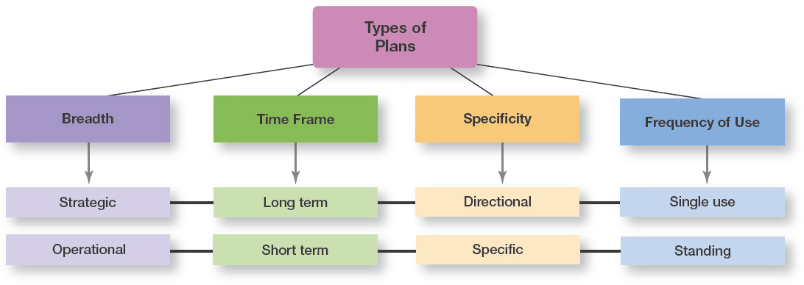
Exhibit 8-1 Types of Plans
© Pearson Education Limited 2016

Slide 14
Approaches to Setting Goals
Traditional Goal-Setting – An approach to setting goals in which top managers set goals that then flow down through the organization and become sub-goals for each organizational area.
Means-Ends Chain – An integrated network of goals in which the accomplishment of goals at one (lower) level serves as the means for achieving the goals, or ends, at the next (higher) level.
That’s how traditional goal-setting works.
© Pearson Education Limited 2016
Notes:
In traditional goal-setting, goals set by top managers flow down through the organization and become subgoals for each organizational area. This traditional perspective assumes that top managers know what’s best because they see the “big picture.” And the goals passed down to each succeeding level guide individual employees as they work to achieve those assigned goals.
When the hierarchy of organizational goals is clearly defined it forms an integrated network of goals, or a means-ends chain.
Higher-level goals (or ends) are linked to lower-level goals, which serve as the means for their accomplishment. In other words, the goals achieved at lower levels become the means to reach the goals (ends) at the next level. And the accomplishment of goals at that level becomes the means to achieve the goals (ends) at the next level and on up through the different organizational levels. That’s how traditional goal-setting is supposed to work.

Slide 15
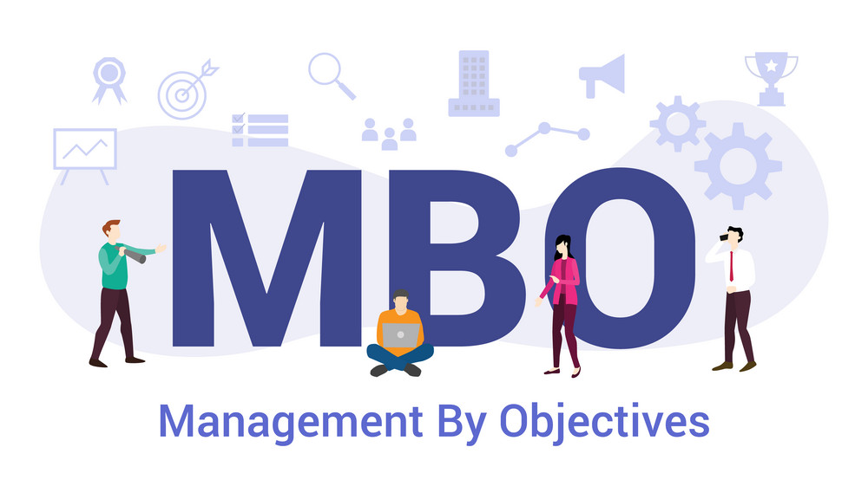
Approaches to Setting Goals
Management by Objectives (MBO) – A process of setting mutually agreed upon goals and using those goals to evaluate employee performance.
© Pearson Education Limited 2016
Notes:
Instead of using traditional goal-setting, many organizations use management by objectives (MBO), a process of setting mutually agreed-upon goals and using those goals to evaluate employee performance. MBO programs have four elements: goal specificity, participative decision-making, an explicit time period, and performance feedback.
Instead of using goals to make sure employees are doing what they’re supposed to be doing, MBO uses goals to motivate them as well. The appeal is that it focuses on employees working to accomplish goals they’ve had a hand in setting.

Slide 16
Exhibit 8-3 Steps in MBO
Step 1: The organization’s overall objectives and strategies are formulated.
Step 2: Major objectives are allocated among divisional and departmental units.
Step 3: Unit managers collaboratively set specific objectives for their units with their managers.
Step 4: Specific objectives are collaboratively set with all department members.
Step 5: Action plans, defining how objectives are to be achieved, are specified and agreed upon by managers and employees.
Step 6: The action plans are implemented.
Step 7: Progress toward objectives is periodically reviewed, and feedback is provided.
Step 8: Successful achievement of objectives is reinforced by performance-based rewards.
© Pearson Education Limited 2016

Slide 17
Steps in Goal-Setting
Review the organization’s mission, or purpose.
Evaluate available resources.
Determine the goals individually or with input from others.
Write down the goals and communicate them to all who need to know.
Review results and whether goals are being met.
© Pearson Education Limited 2016

Slide 18
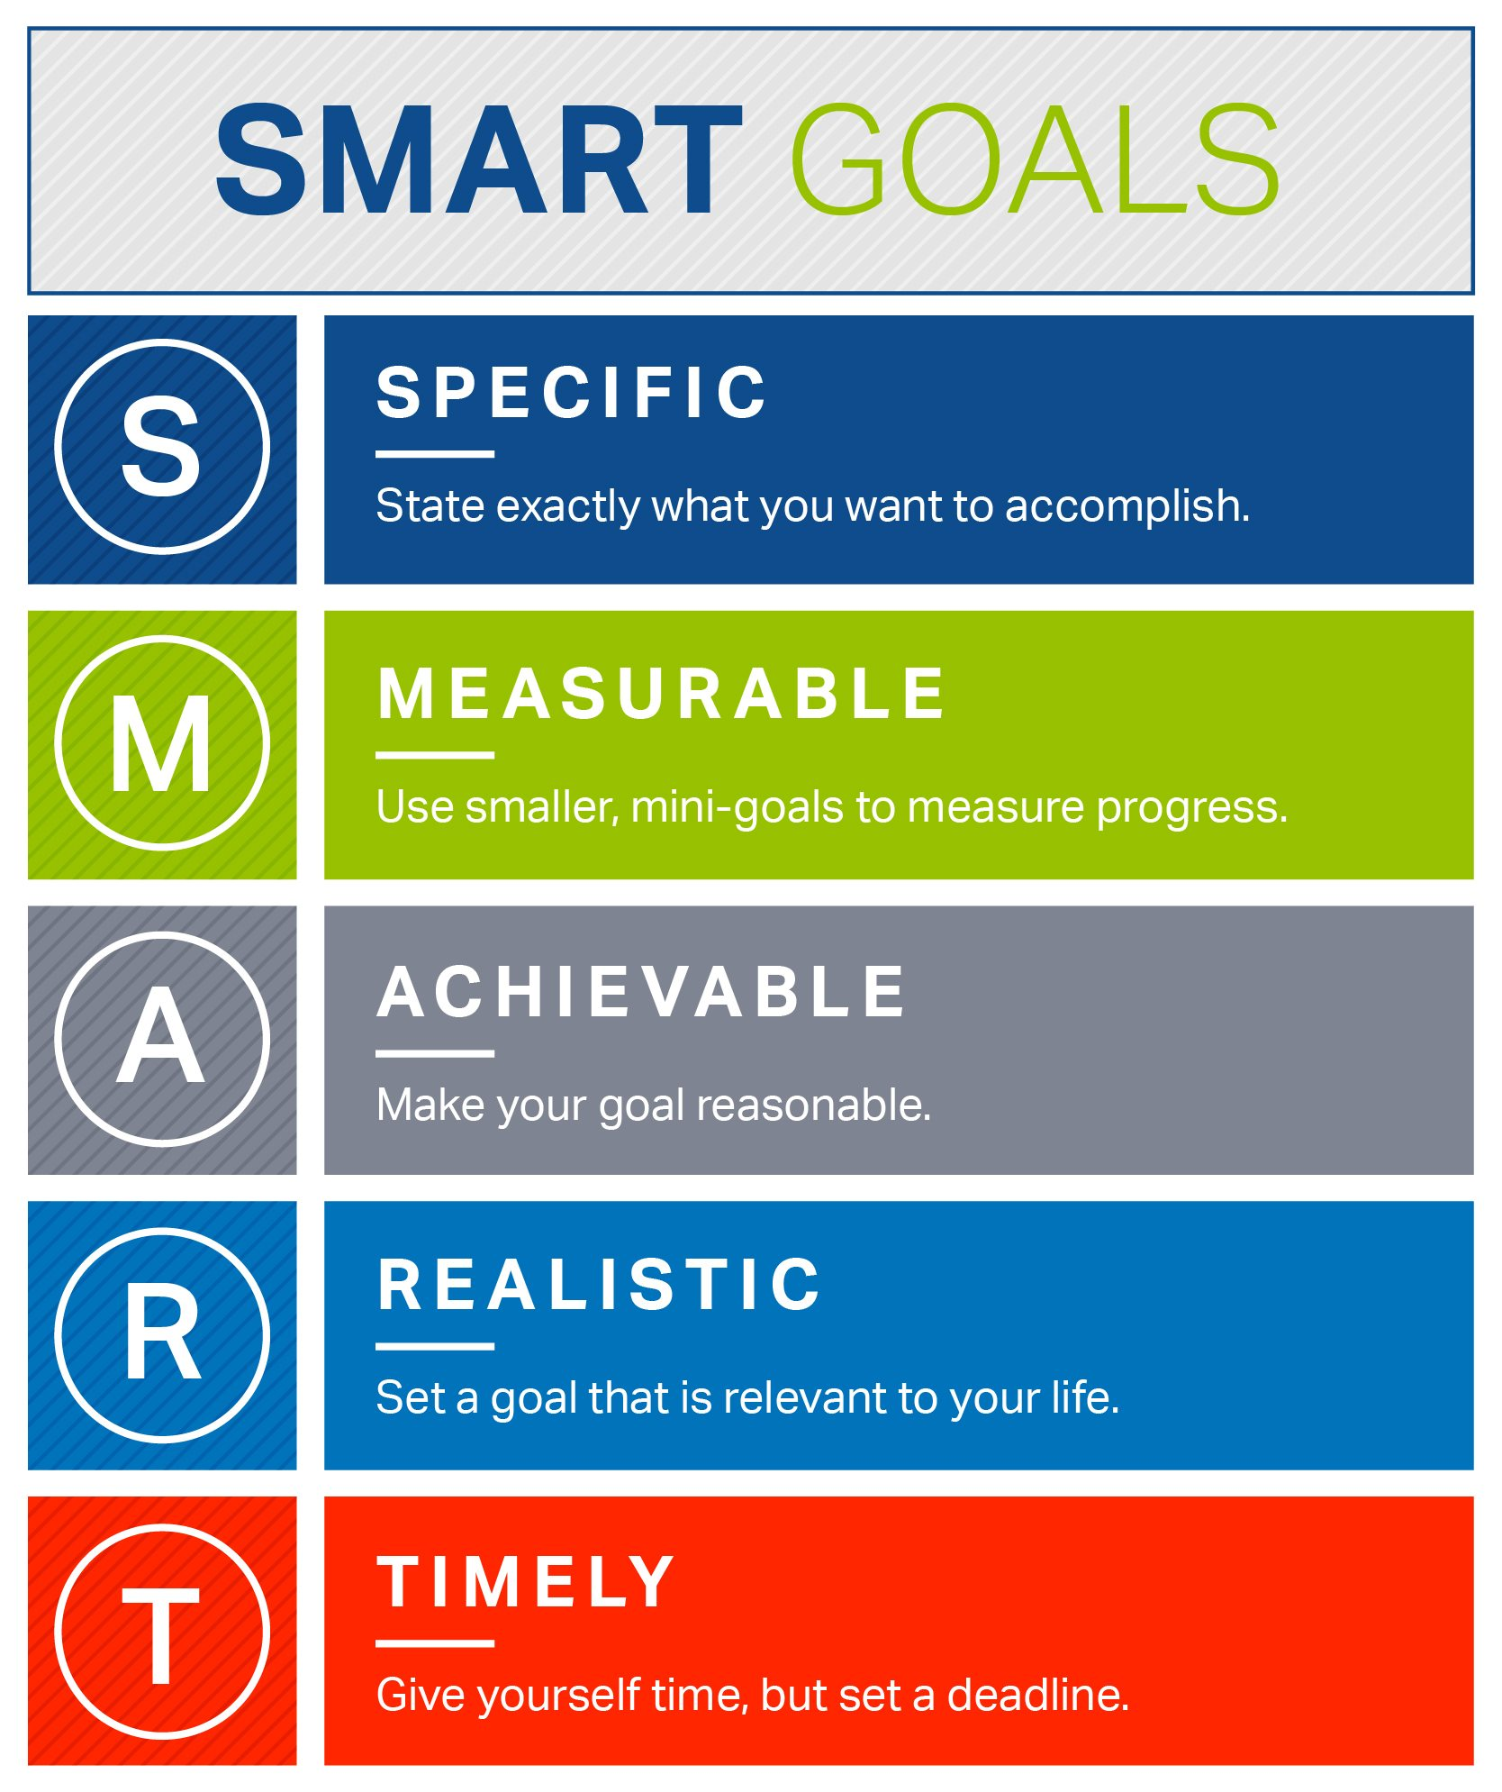
Exhibit 8-4 Well-Written Goals
Written in terms of outcomes rather than actions
Measurable and quantifiable
Clear as to a time frame
Challenging yet attainable
Written down
Communicated to all necessary organizational members
© Pearson Education Limited 2016

Slide 19
Contingency Factors in Planning
Three contingency factors affect the choice of plans:
Organizational Level
Degree of Environmental Uncertainty
Length of Future Commitments
© Pearson Education Limited 2016

Slide 20
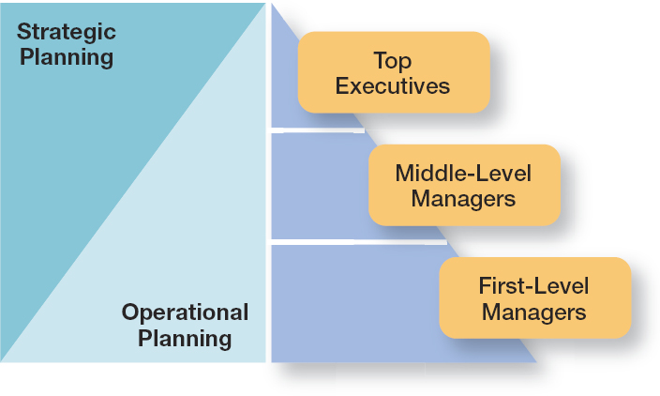
Exhibit 8-5 Planning and Organizational Level
© Pearson Education Limited 2016

Slide 21
Contingency Factors in Planning
Environmental Uncertainty:
When uncertainty is high, plans should be specific, but flexible
Managers must be prepared to change or amend plans as they’re implemented
At times, they may even have to abandon the plans
© Pearson Education Limited 2016

Slide 22
Contingency Factors in Planning
Length of future commitments:
Commitment Concept: Current plans affecting future commitments must be sufficiently long-term in order to meet those commitments.
© Pearson Education Limited 2016

Slide 23
Contingency Factors in Planning
In the traditional approach, planning is done entirely by top-level managers, often assisted by a formal planning department.
Formal planning department – A group of planning specialists whose sole responsibility is helping to write organizational plans.
© Pearson Education Limited 2016

Slide 24
Contemporary Issues in Planning
How Can Managers Plan Effectively in Dynamic Environments?
In an uncertain environment, managers should develop plans that are specific, but flexible
Managers need to recognize that planning is an ongoing process
© Pearson Education Limited 2016

Slide 25
Contemporary Issues in Planning
How Can Managers Use Environmental Scanning?
Environmental Scanning – Screening information to detect emerging trends.
Competitor Intelligence – Gathering information about competitors that allows managers to anticipate competitors’ actions rather than merely reacting to them.
© Pearson Education Limited 2016

Slide 26
Review Learning Objective 8.1
Define the nature and purposes of planning.
Planning involves defining the organization’s goals, establishing an overall strategy for achieving those goals, and developing plans for organizational work activities.
The four purposes of planning include providing direction, reducing uncertainty, minimizing waste and redundancy, and establishing the goals or standards used in controlling.
© Pearson Education Limited 2016

Slide 27
Review Learning Objective 8.2
Classify the types of goals organizations might have and the plans they use.
Goals are desired outcomes.
Plans are documents that outline how goals are going to be met.
Strategic plans apply to the entire organization while operational plans encompass a particular functional area.
© Pearson Education Limited 2016

Slide 28
Review Learning Objective 8.2
Long-term plans are those with a time frame beyond three years. Short-term plans cover one year or less.
Specific plans are clearly defined and leave no room for interpretation.
Directional plans are flexible and set out general guidelines.
A single-use plan is a one-time plan designed to meet the needs of a unique situation.
Standing plans are ongoing plans that provide guidance for activities performed repeatedly.
© Pearson Education Limited 2016

Slide 29
Review Learning Objective 8.3
Compare and contrast approaches to goal-setting and planning.
In traditional goal-setting, goals are set at the top of the organization and then become subgoals for each organizational area.
MBO (management by objectives) is a process of setting mutually agreed-upon goals and using those goals to evaluate employee performance.
© Pearson Education Limited 2016

Slide 30
Review Learning Objective 8.3
Well-written goals have six characteristics:
Written in terms of outcomes.
Measurable and quantifiable.
Clear as to time frame.
Challenging but attainable.
Written down.
Communicated to all organizational members who need to know them.
© Pearson Education Limited 2016

Slide 31
Review Learning Objective 8.3
Goal-setting involves these steps:
Review the organization’s mission
Evaluate available resources
Determine the goals individually or with input from others
Write down the goals and communicate them to all who need to know them
Review results and change goals as needed
© Pearson Education Limited 2016

Slide 32
Review Learning Objective 8.3
The two main approaches to planning include:
The traditional approach, which has plans developed by top managers that flow down through other organizational levels and which may use a formal planning department.
The other approach is to involve more organizational members in the planning process.
© Pearson Education Limited 2016

Slide 33
Review Learning Objective 8.4
Discuss contemporary issues in planning.
Dynamic environments – Usually means developing plans that are specific but flexible.
Contemporary planning issue involves using environmental scanning to help do a better analysis of the external environment.
One form of environmental scanning, competitive intelligence, can be especially helpful in finding out what competitors are doing.
© Pearson Education Limited 2016

